Slide 1
Stage 2: Teeth

Slide 2
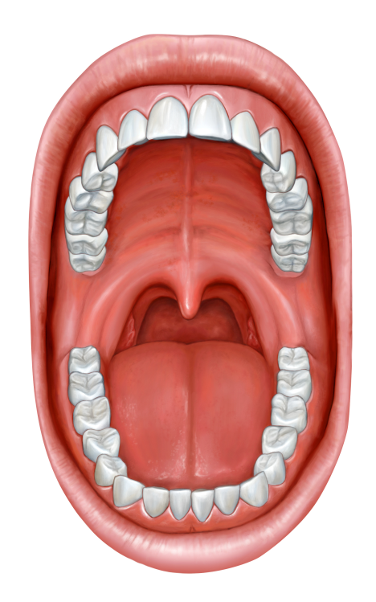
Learning Objective:
To identify the different types of teeth in humans and their simple functions
This lesson we will learn all about teeth and how to keep them healthy. We will be using this learning to help us develop our calcium-rich food products in the next stage of the project.

Slide 3
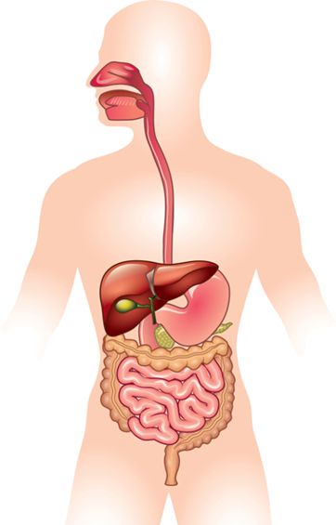
Let’s warm up our brains with a vertical relay!
Work as a relay team, to label the diagram with everything you can remember as fast as you can!

Slide 4
Exploring our teeth
Use the mirror to examine your teeth:
How many do you have?
How many differently shaped teeth can you see?

Slide 5
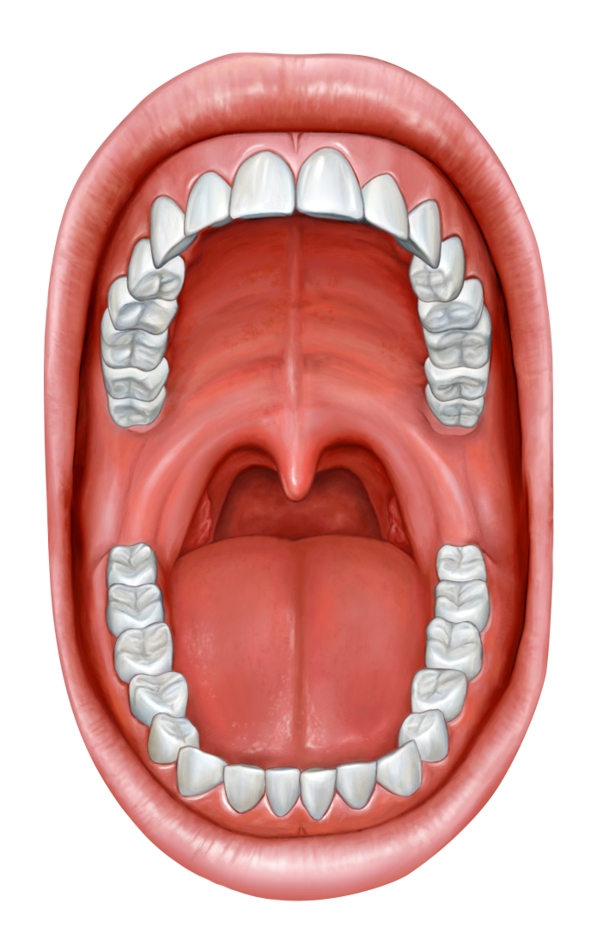
Incisors
Incisors are at the front of your mouth.
They are used for biting off pieces of food and starting to chew them.

Slide 6
Canines
Incisors are at the sides of your mouth. They are more pointed than incisors.
They are used for tearing and ripping food.

Slide 7
Molars
Molars are at the back of your mouth. They are larger and flatter than your other teeth.
They are used for crushing and grinding food.

Slide 8
Plotting a tooth map
Use the mirror to help you plot a map of your teeth.
Remember to identify and label the different types of teeth and explain what their jobs are.
Top jaw
Bottom jaw

Slide 9
Keeping our teeth healthy
It is important to look after our teeth. Cleaning them well, eating healthy foods, and visiting the dentist regularly can help to keep our teeth and gums healthy.
Some foods can help to keep our bones and teeth strong. Can you think of any?

Slide 10
Calcium is very important for healthy bones and teeth
Dairy products contain calcium.
How many dairy products can you think of?

Slide 11
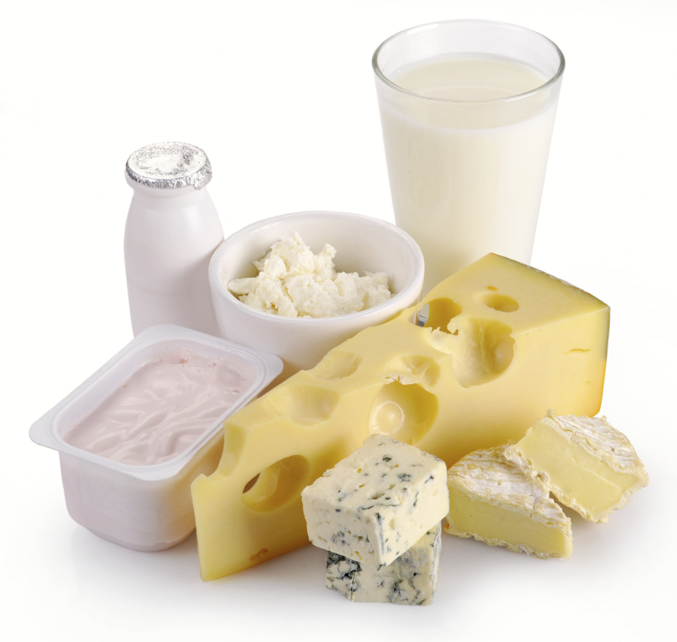
Dairy products for a healthy smile!
Milk
Butter
Cream
Cheese
Yoghurt

